Slide 1
The History, Ecology and Future of Eucalyptus Plantations in the Bay Area
Joe R. McBride
Department of Landscape Architecture and Environmental Planning
and
Department of Environmental Science, Policy and Management
University of California
Berkeley, CA

Slide 2
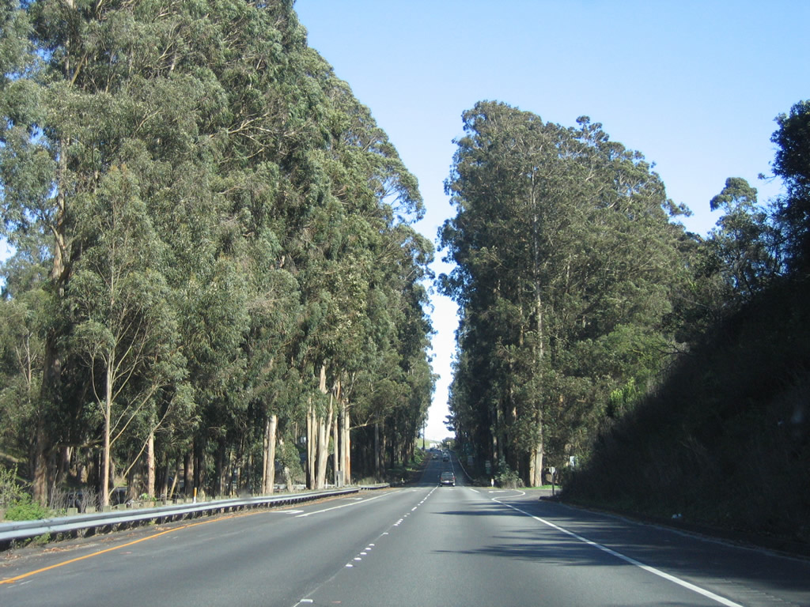

Slide 3
“The Eucalyptus seems an indispensable element of this State’s landscapes,
as indigenously Californian as the redwoods, the poppy fields, the long white
coastal beaches, the gleaming granite of the High Sierra.” H. Gilliam, 1965

Slide 4
Overview
1. History of eucalyptus in California
2. Characteristics of eucalyptus plantations
3. Modification of site conditions by eucalyptus
4. Eucalyptus forests as habitat for wildlife
5. Future of eucalyptus plantations in California

Slide 5
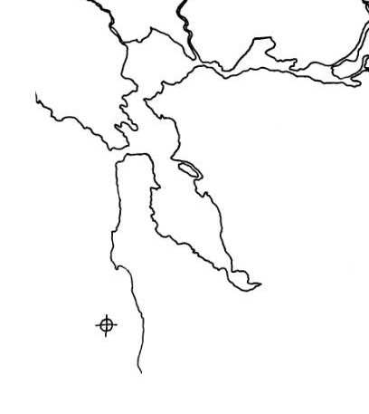
Location of Eucalyptus Study Sites
•
Jack London State Park
•
Pt. Pinole
•
•
Tilden Park
Angle Island
•
Strawberry Canyon
•
• Redwood Park
East Ft. Baker
•
•
•
Lands End
Presidio
Mills College
• Chabot Park
Burleigh Murray Ranch State Park
•

Slide 6
History
• Initial Introduction
• Planting during the 1870s
• Planting from 1906-1913
• Planting in the latter half
of the 20th century

Slide 7
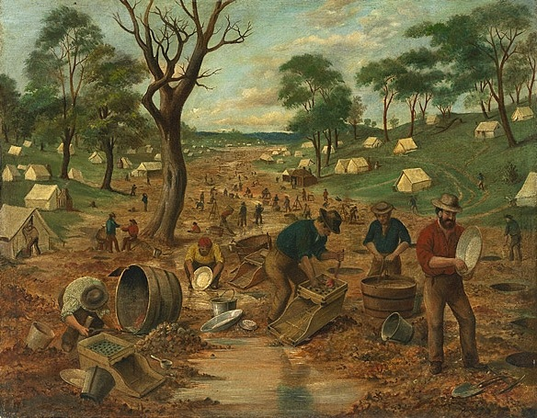
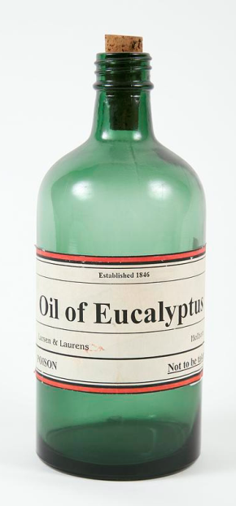
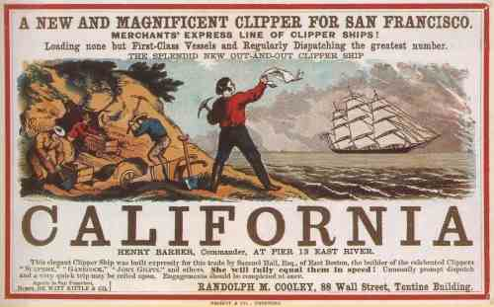

Initial Introduction of Eucalyptus to California

Slide 8
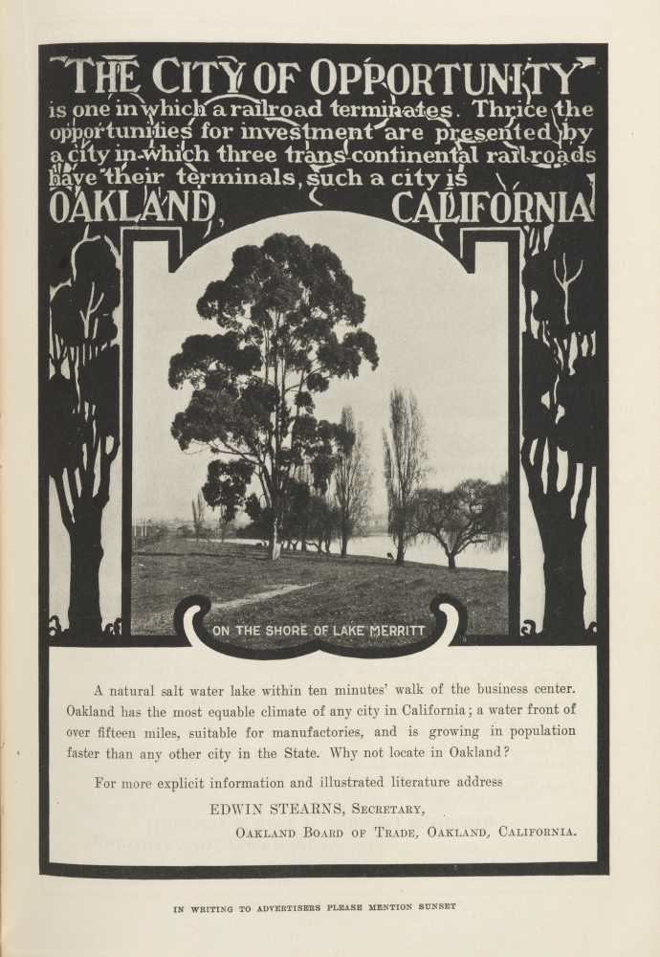
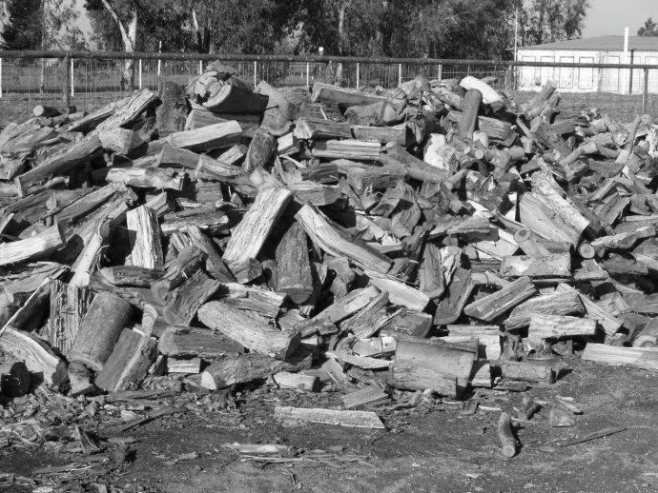
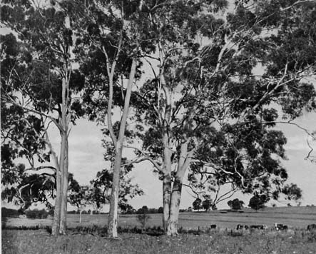
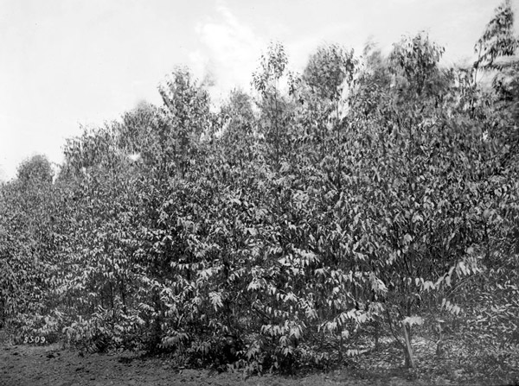
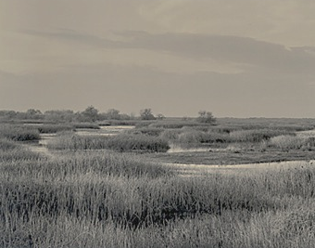
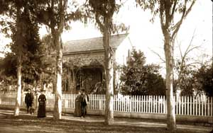
Eucalyptus Planting in the 1870s

Slide 9
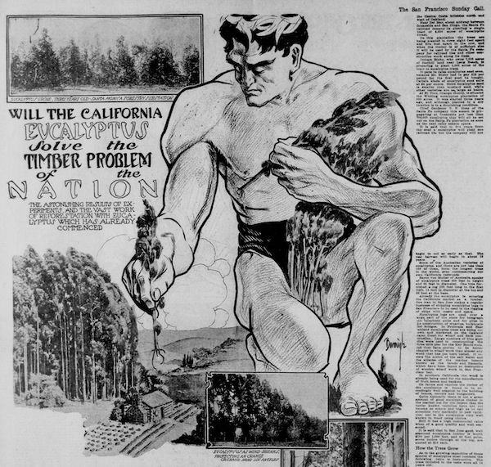
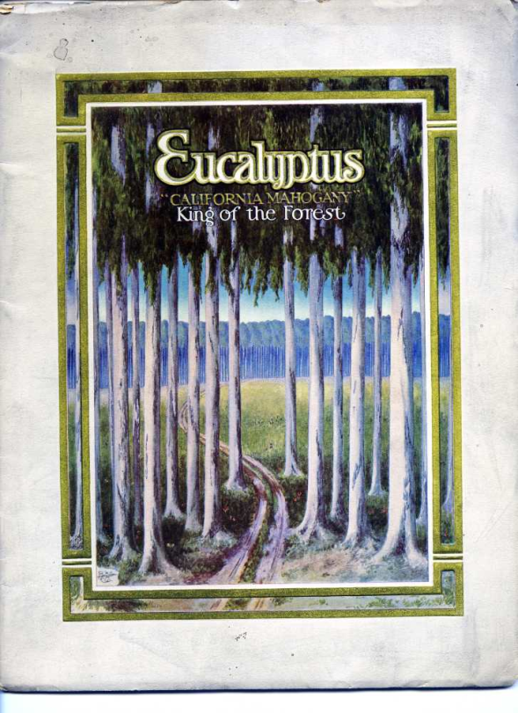
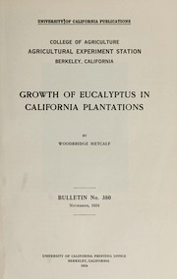
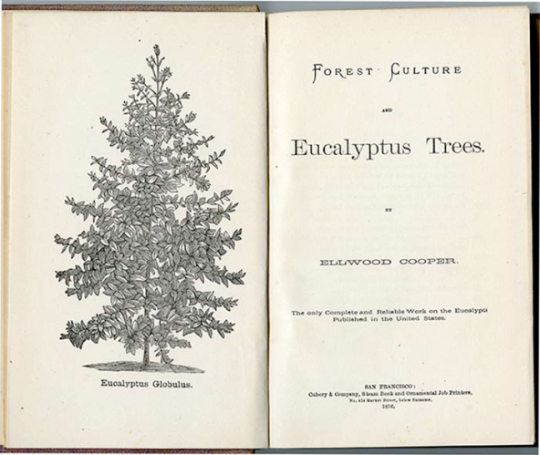
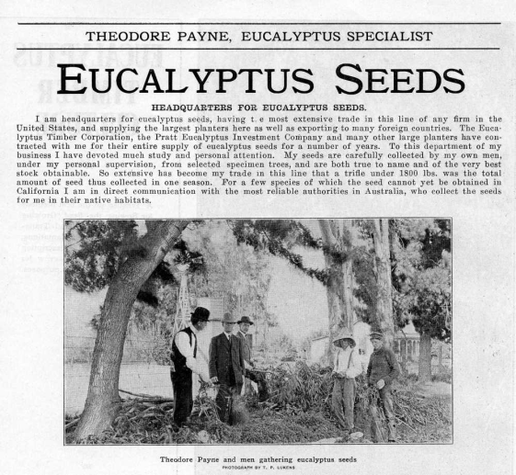
Eucalyptus Planting 1906 -1912

Slide 10
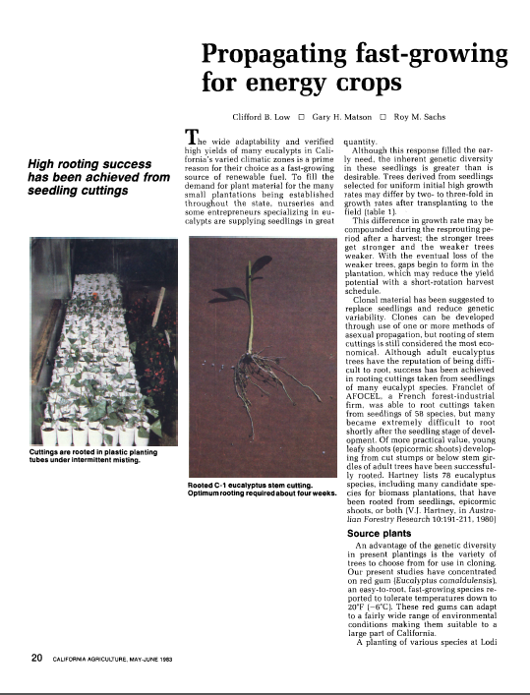
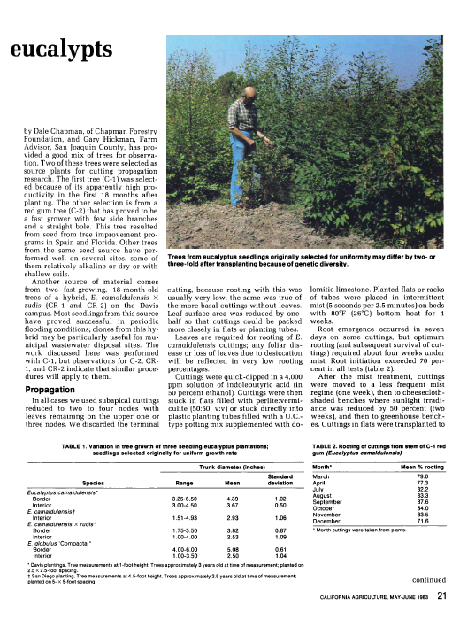
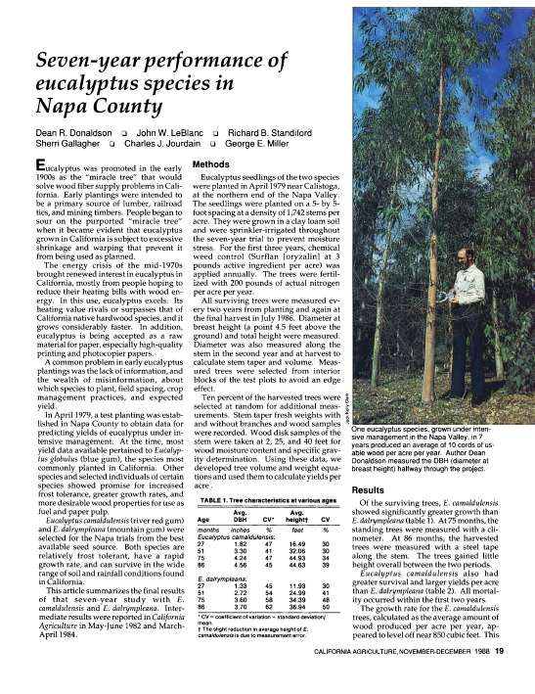
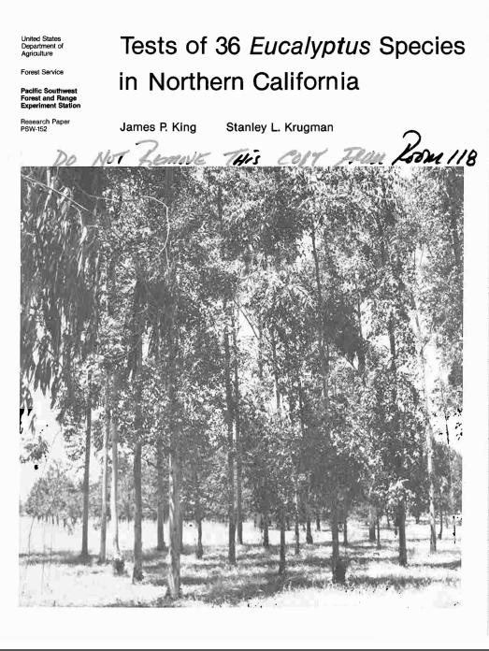
Latter Half of the 20th Century

Slide 11
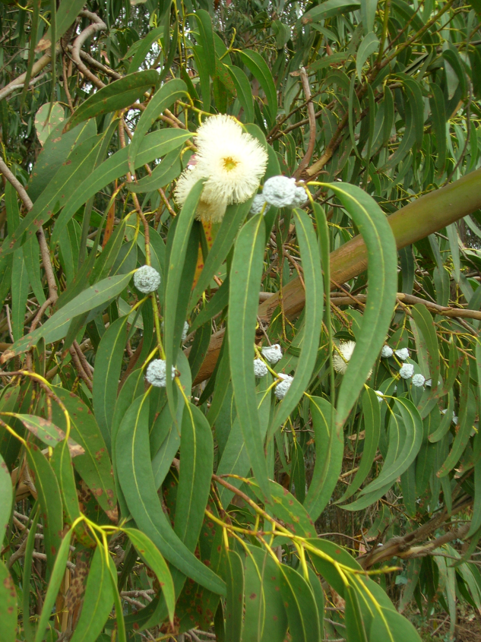
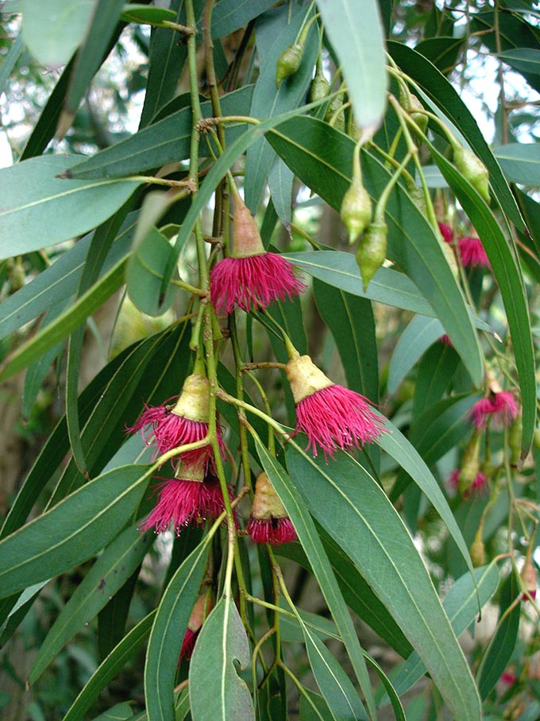
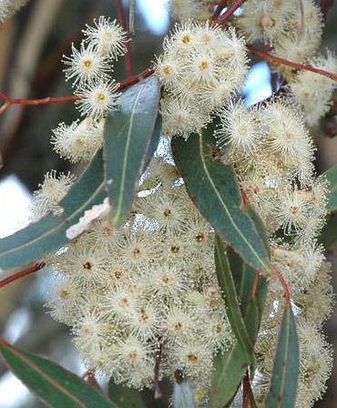
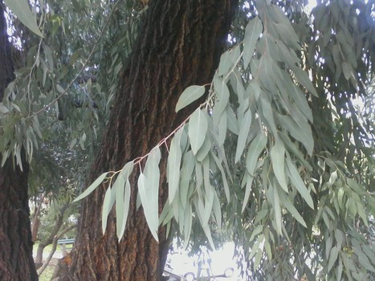
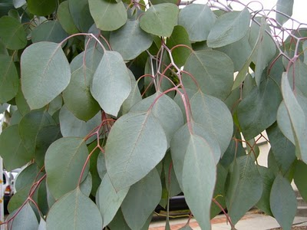
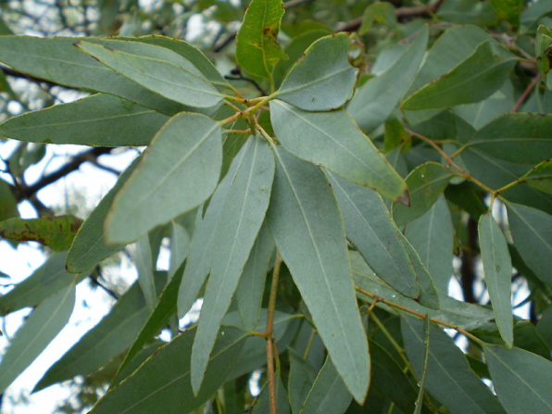
Blue Gum Red Gum Sugar Gum
Major Species of Eucalyptus Planted in California
Red Ironbark Silver Dollar Lemon Scented

Slide 12
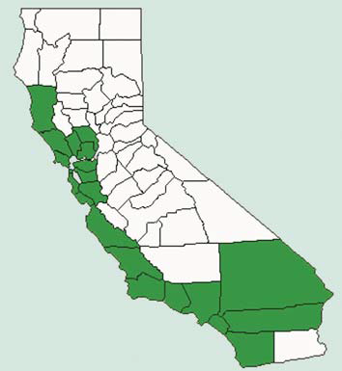
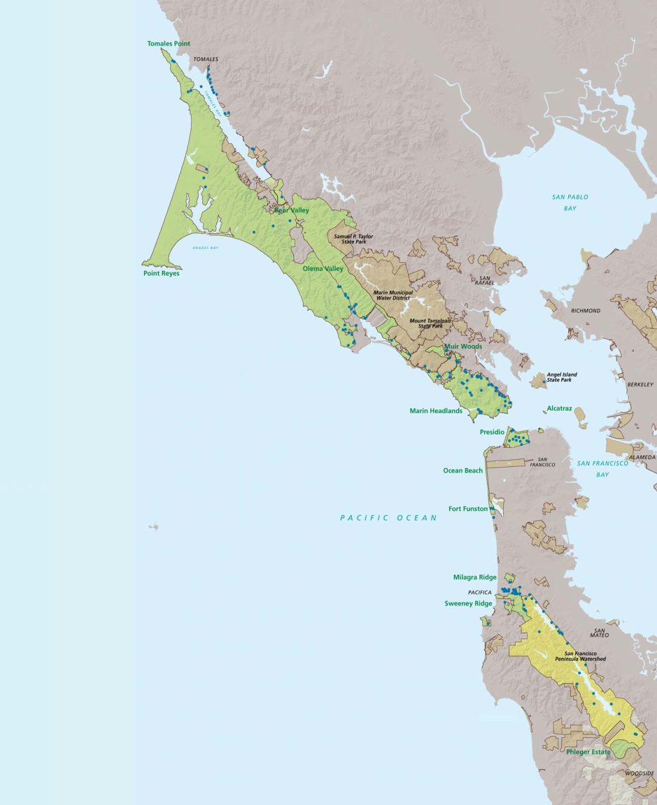
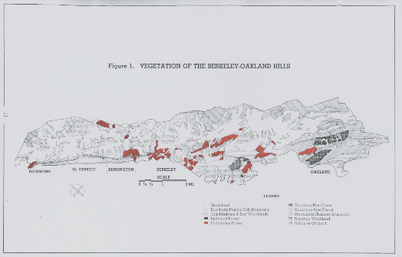
Distribution of Blue Gum Eucalyptus

Slide 13
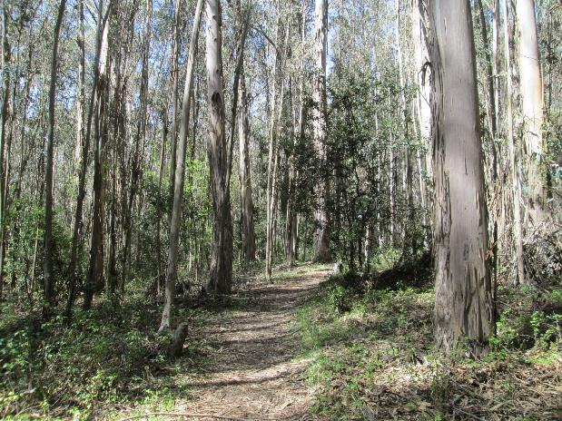
Characteristics of Eucalyptus Plantations

Slide 14
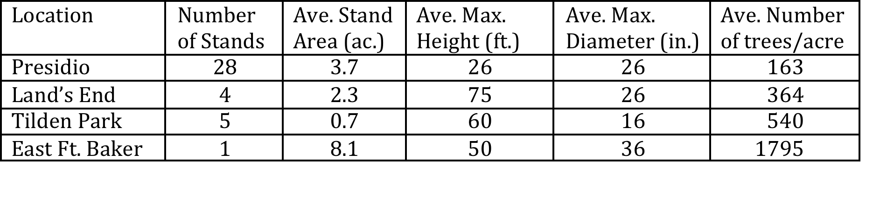
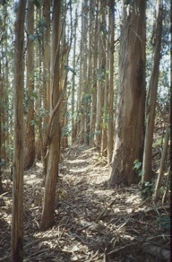
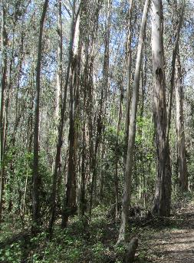
Structural Characteristics
80

Slide 15
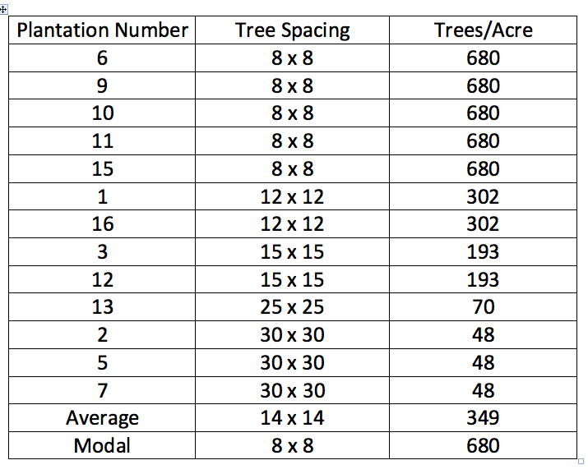
Initial Spacing of Trees in Plantations
(Angel Island State Park)

Slide 16
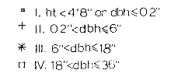
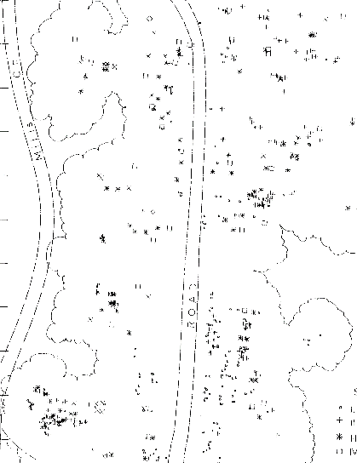
Diameter Distribution of Eucalyptus along Mill Creek
(Burleigh Murray Ranch State Park)
Size Class
Size Class Density per Acre
I 57
II 27
III 25
IV 17
0 40’

Slide 17
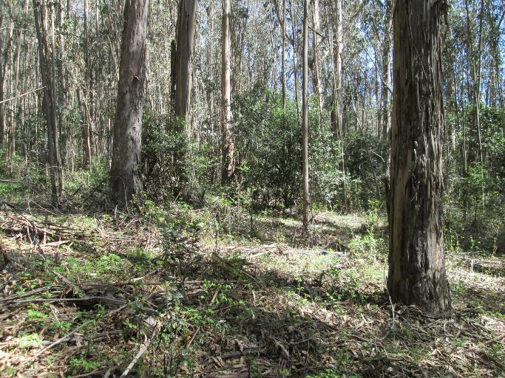
Species Composition of Eucalyptus Plantations

Slide 18
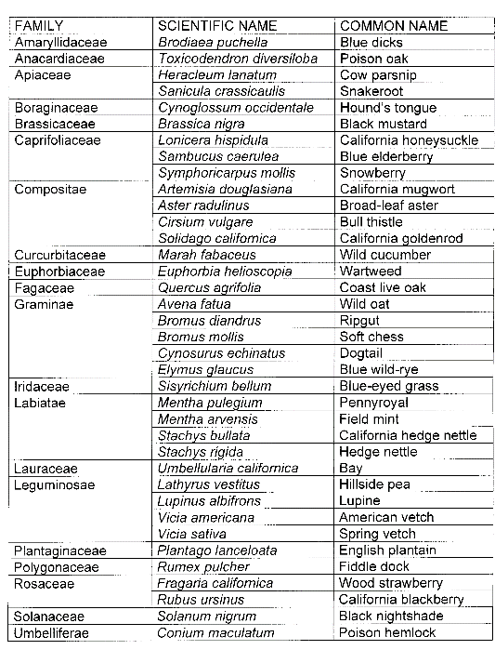
Eucalyptus Understory
Plant Species Survey
(Tilden Park – 1990)
Summary
Number of Families = 21
Number of Genera = 34
Number of Species = 38
Crucifereae | Dentaria californica | Milkmaids

Slide 19
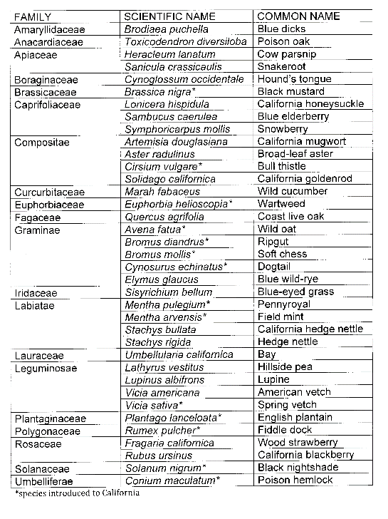
Introduced Species
Eucalyptus Understory
Plant Species Survey
(Tilden Park – 1990)
Summary
Number of Families = 21
Number of Genera = 34
Number of Species = 38
Native to California = 24
*Introduced to California = 14
Crucifereae | Dentaria californica | Milkmaids

Slide 20
Comparison of Species composition of Eucalyptus with Oak Woodland
(Tilden Park – 1990)
Oak Woodland
Number of Families = 16
Number of Genera = 19
Number of Species = 19
Native to California = 14
Introduced to California = 5
Eucalyptus Plantation
Number of Families = 21
Number of Genera = 34
Number of Species = 38
Native to California = 24
Introduced to California = 14

Slide 21
Plant Species Richness in Eucalyptus Plantations and Oak Woodlands
Location Habitat Vegetation Type Number of Species
Tilden Park¹ Upland Eucalyptus 21
Oak Woodland 12
Tilden Park² Upland Eucalyptus 38
Oak Woodland 21
Murray Park³ Riparian Eucalyptus 34
Riparian Woodland 58
1 = Jewell Lake (Contra Costa County); 2 = Golf Course Road (Contra Costa County); 3 = San Mateo County, near Half Moon Bay

Slide 22
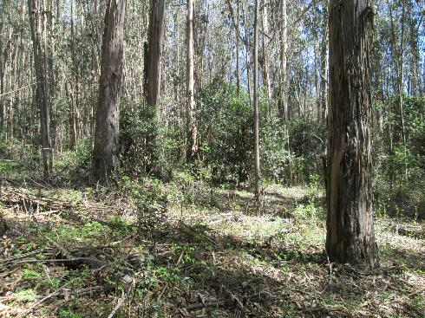
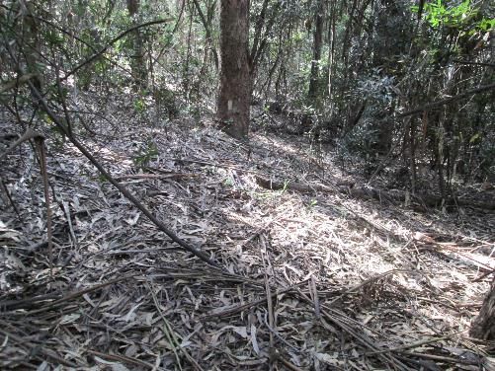
Understory Conditions and the Establishment of
Plant Species
South Facing Slope
Edge Site: 15 species
Interior Site: 15 species
North Facing Slope
Edge Site: 8 species
Interior Site: 8 species

Slide 23
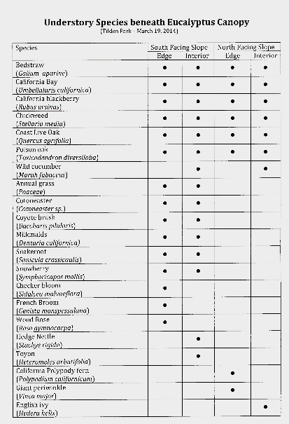
Variation in Understory Species in Eucalyptus Plantations

Slide 24
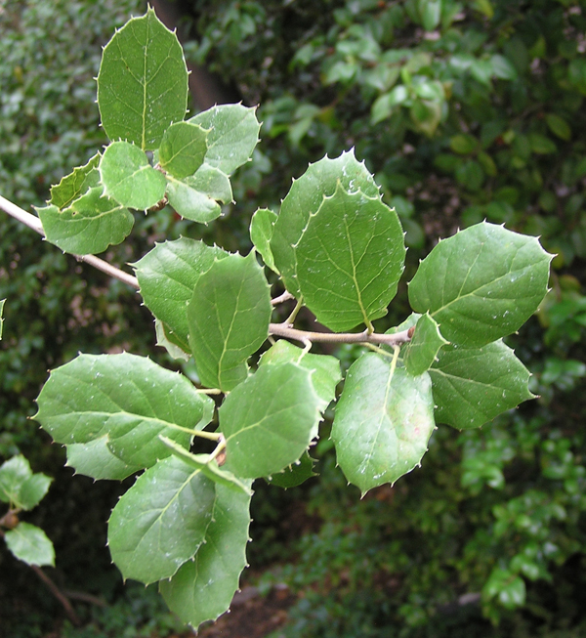
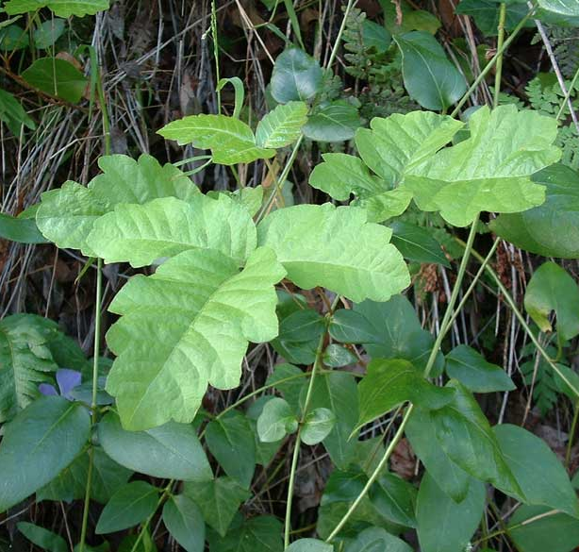
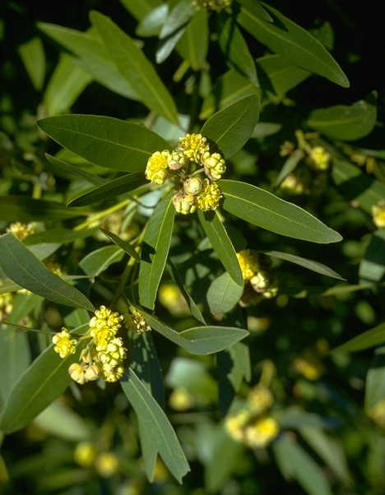
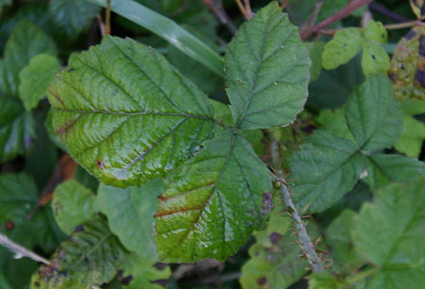
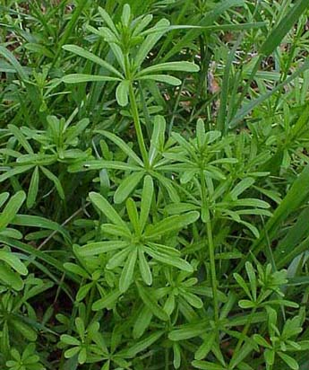
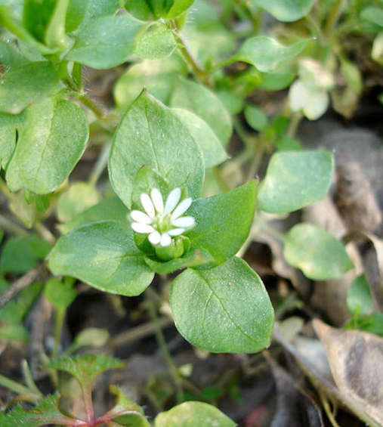
Ubiquitous Understory Species
California Bay Coast Live oak Poison Oak California Blackberry
Bedstraw Chickweed

Slide 25
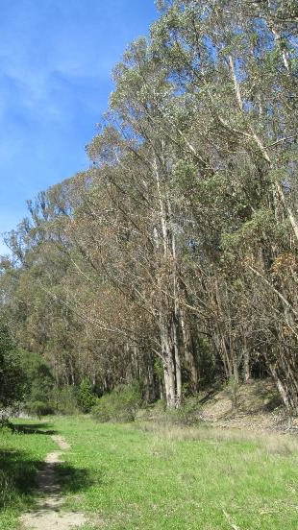
Modification of Site Conditions by Eucalyptus
• Microclimate
• Soil
• Streams

Slide 26
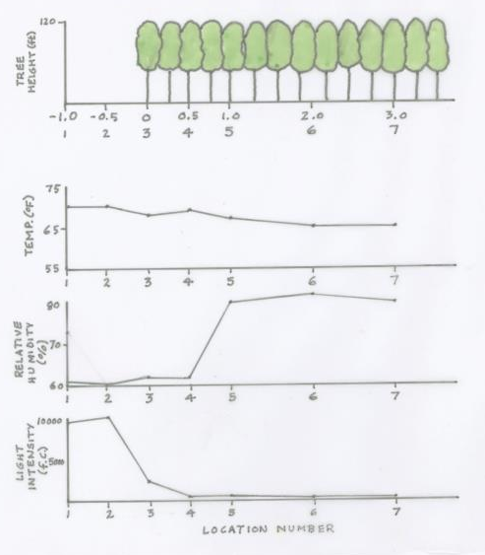
Effects of Eucalyptus Plantation on Microclimate
(Tilden Park, 2101)

Slide 27
Eucalyptus Modification of Grassland Microclimates
(Presidio)
Factor Modification under Eucalyptus
Temperature (day) - 10%
Temperature (night) + 5%
Relative Humidity + 5%
Light Intensity - 90%
Wind Velocity - 40%
Precipitation - 12%
Fog Drip + 300%

Slide 28

Effects of Eucalyptus on Soil Characteristics

Slide 29
Effects of Eucalyptus on Soil Characteristics
(Zinke et al, 1988)
Grassland Eucalyptus
pH Carbon (%) Nitrogen (%) Phosphorus (ppm)
0.4
5
7
5
2.5
0.2
2.5
4
4
4
Calcium* Magnesium* Potassium* Sodium*
40
8
.6
.3
.2
20
4
.3
.1
* meq/100gm

Slide 30


Allelopathic Effects of Eucalyptus

Slide 31



Eucalyptus Litter and Stream Insects

Slide 32
Eucalyptus Litter and Stream Insects
(Lacan, Resh, and McBride, 2009)
Litter Type Annual Input Decomposition Macroinvertebrate
Eucalyptus 950 gm/m²/yr 0.0193 gm/day
species richness
species diversity
pollution tolerance
Native Riparian 669 gm/m²/yr 0.0134 gm/day
no significant difference

Slide 33



Wildlife Habitat Value of Eucalyptus Plantations

Slide 34




Use of Habitats in the East Bay Regional Parks
(Stebbins, 1978)
Birds Mammals Reptiles Amphibians

Slide 35
Use of Habitats in the East Bay Regional Parks
(Stebbins, 1978)
Birds Mammals Reptiles Amphibians

Slide 36




Use of Eucalyptus in the East Bay Regional Parks
(Stebbins, 1978)
Birds
Mammals
Reptiles
Amphibians

Slide 37








Birds making “great” use of Eucalyptus habitat
Mourning Dove Great Horned Owl Steller Jay Yellow-bellied Sapsucker
Allen Hummingbird Olive-sided Flycatcher Brown Creeper Dark-eyed Junco Audubon Warbler

Slide 38

Reptiles and Amphibians making “great” use of Eucalyptus habitat
Slender Salamander
Southern Alligator Lizard

Slide 39


Small Mammal Use of Eucalyptus Plantations
(Tilden Park, 1990)
Number of Animals Captured
Vegetation Type Deer Mouse California Meadow Mouse
Eucalyptus 35 0
Grassland 3 1
(*200 trap nights)
*
Deer Mouse California Meadow Mouse
(Peromyscus maniculatus) (Microtus californicus)

Slide 40

Attractiveness of Habitats in the East Bay Regional Parks
(Stebbins, 1978)
All Species Making Use of Habitat

Slide 41



Use of Eucalyptus Plantations by Insects

Slide 42


Eucalyptus and Monarch Butterflies

Slide 43





Eucalyptus Longhorned Borer
(Phorocantha semipunctata)

Slide 44


Parasitic Wasp of Eucalyptus Longhorned Borer
(Avetianella longoi)

Slide 45


Red Gum Lerp Psyllid

Slide 46
Future of eucalyptus plantations
in the San Francisco Bay Area
Successional change
Invasion of adjacent vegetation types
Potential impacts of naturalized pest species

Slide 47
Plant Succession in Eucalyptus Plantations
• Concept of succession
• Current trends in the understory
of Eucalyptus plantations

Slide 48

Plant Succession

Slide 49



Plant Succession in Eucalyptus Plantations
Coast Live oak
California Bay

Slide 50

Comparative Shade Tolerance
Shade
Species Tolerance
Eucalyptus intolerant
Coast Live Oak tolerant
California Bay very tolerant

Slide 51


Oak and Bay in Understory of Eucalyptus
(Tilden Park)

Slide 52
Occurrence of Oak and Bay in Eucalyptus Understory
(Tilden Park, 1990)
•
•
•
•
•
•
•
•
•
•
•
•
•
•
•
•
•
•
•
•
•
•
•
•
•
•
•
•
•
•
•
•
•
•
•
•
•
•
•
•
•
•
•
•
•
•
•
•
•
•
•
•
•
•
•
•
•
•
•
•
•
•
•
•
•
•
•
•
•
•
•
•
•
•
•
•
•
•
•
•
•
•
•
•
•
•
•
•
•
•
•
•
•
•
•
•
•
•
•
•
•
•
•
•
•
•
•
•
•
•
•
•
•
•
•
•
•
•
•
•
•
•
•
•
•
•
•
•
•
•
•
•
•
•
•
•
•
•
•
•
•
•
•
•
•
•
•
•
•
•
•
•
•
•
•
•
•
•
•
•
•
•
•
•
•
•
•
•
•
•
•
•
•
•
•
•
•
•
•
•
•
•
•
•
•
•
•
•
•
•
•
•
•
•
•
•
•
•
•
•
•
•
•
•
•
•
•
•
•
•
•
•
•
•
•
•
•
•
•
•
•
•
•
•
•
•
•
•
•
•
•
•
•
•
•
•
•
•
•
•
0 50’
•
•
Oak
•
Eucalyptus
Bay

Slide 53

Oak and Bay Trees in Eucalyptus Plantations
(Tilden Park, 1990)

Slide 54

Succession in Eucalyptus Plantations

Slide 55

Fire and Eucalyptus

Slide 56



Fuel Loading in Eucalyptus Plantations
From: U. S. National Park Service

Slide 57




Response of Eucalyptus to Burning

Slide 58


Succession in Eucalyptus Plantations
Without Fire:
With Fire:
Fire
Burned Mature
Plantation Plantation

Slide 59
Future of Eucalyptus Plantations
in the San Francisco Bay Area
Successional change
Invasion of adjacent vegetation types
Management objectives

Slide 60

Eucalyptus Plantations on Angel Island
(1988)

Slide 61

Expansion of Eucalyptus Plantations on Angel Island

Slide 62




Expansion of Eucalyptus Plantations on Angel Island

Slide 63



Stable Boundaries of Eucalyptus Plantations
Tilden Park 1935 Tilden Park 1965

Slide 64




Decline in Area of Eucalyptus
(1939-1997)

Slide 65
Decline in Eucalyptus in Three East Bay Parks
10
-
Average Area Eucalyptus Forest (%)
5
-
1939 1968 1983 1997
Year

Slide 66



Alternative Management Objectives for Eucalyptus Plantations
Wood Products
Recreation
Removal

Slide 67




Slide 68

Acknowledgements
David Amme
Jim Bertenshaw
David Boyd
Sheauchi Cheng
Peter Ehrlich
Igor Lacan
John Leffingwell
Rowan Rowntree
Will Russell
Al Stangenberger
Neil Sugihare
Paul Zinke

Slide 69
End

Slide 70


California Bay in Understory of Eucalyptus
(Tilden Park)

Slide 71
Decline in Eucalyptus in Three East Bay Parks
10
-
Average Area Eucalyptus Forest (%)
5
-
1939 1968 1983 1997
Year

Slide 72


Attractiveness of Habitats in the East Bay Regional Parks
(Stebbins, 1978)

